Slide 1



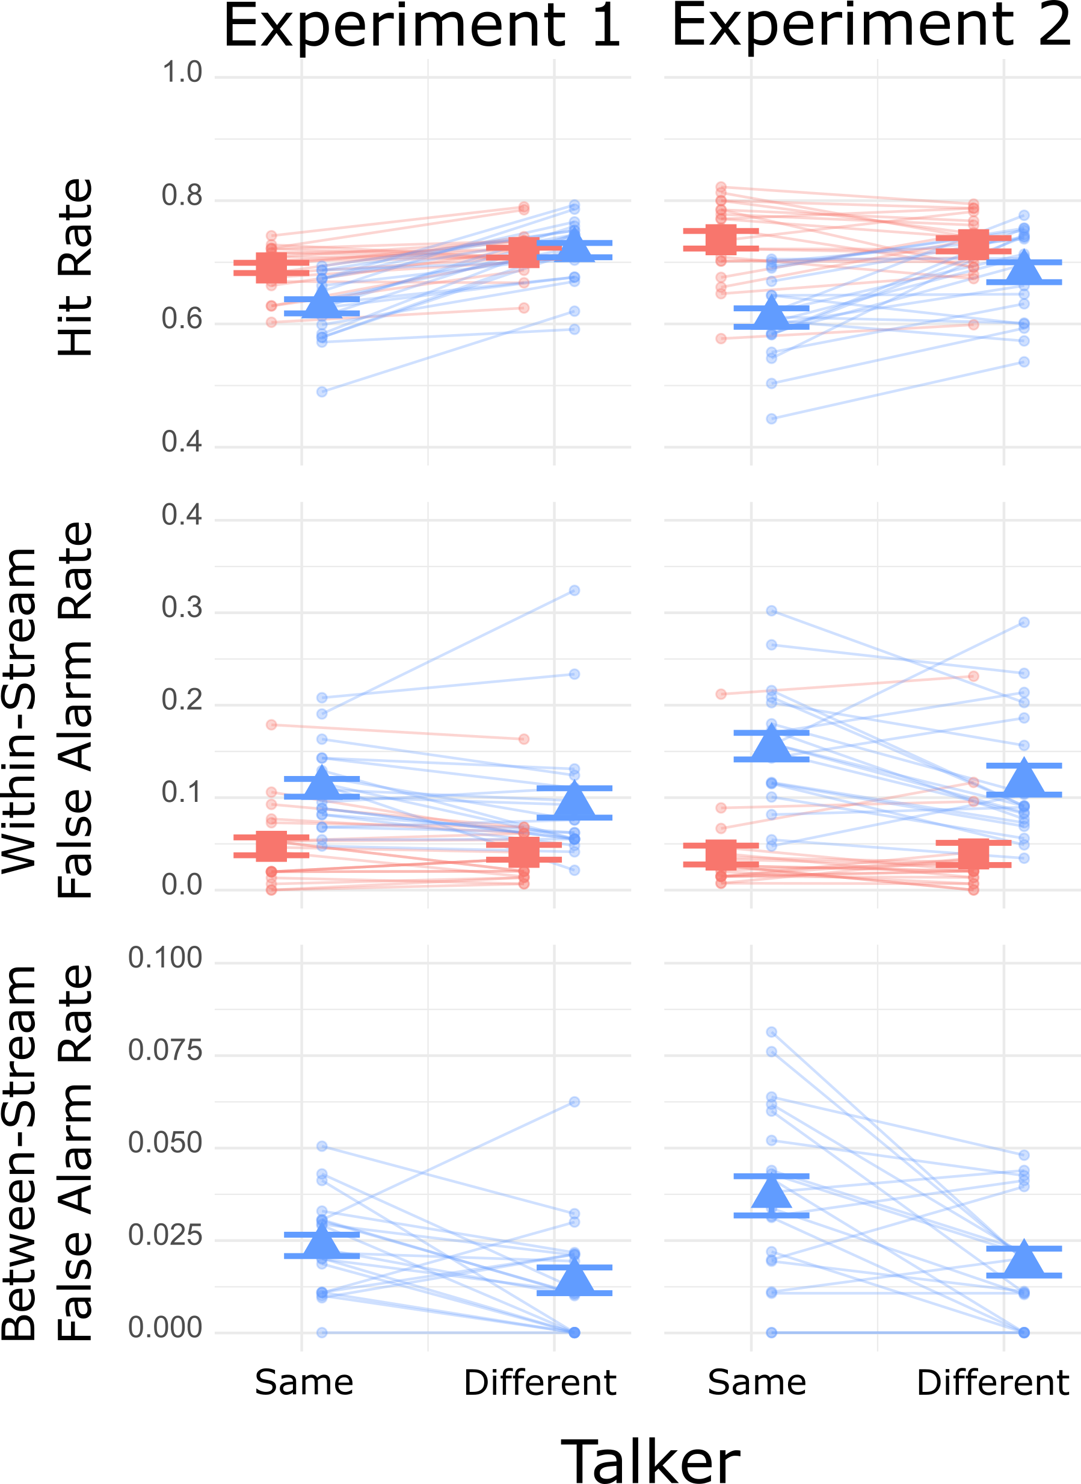
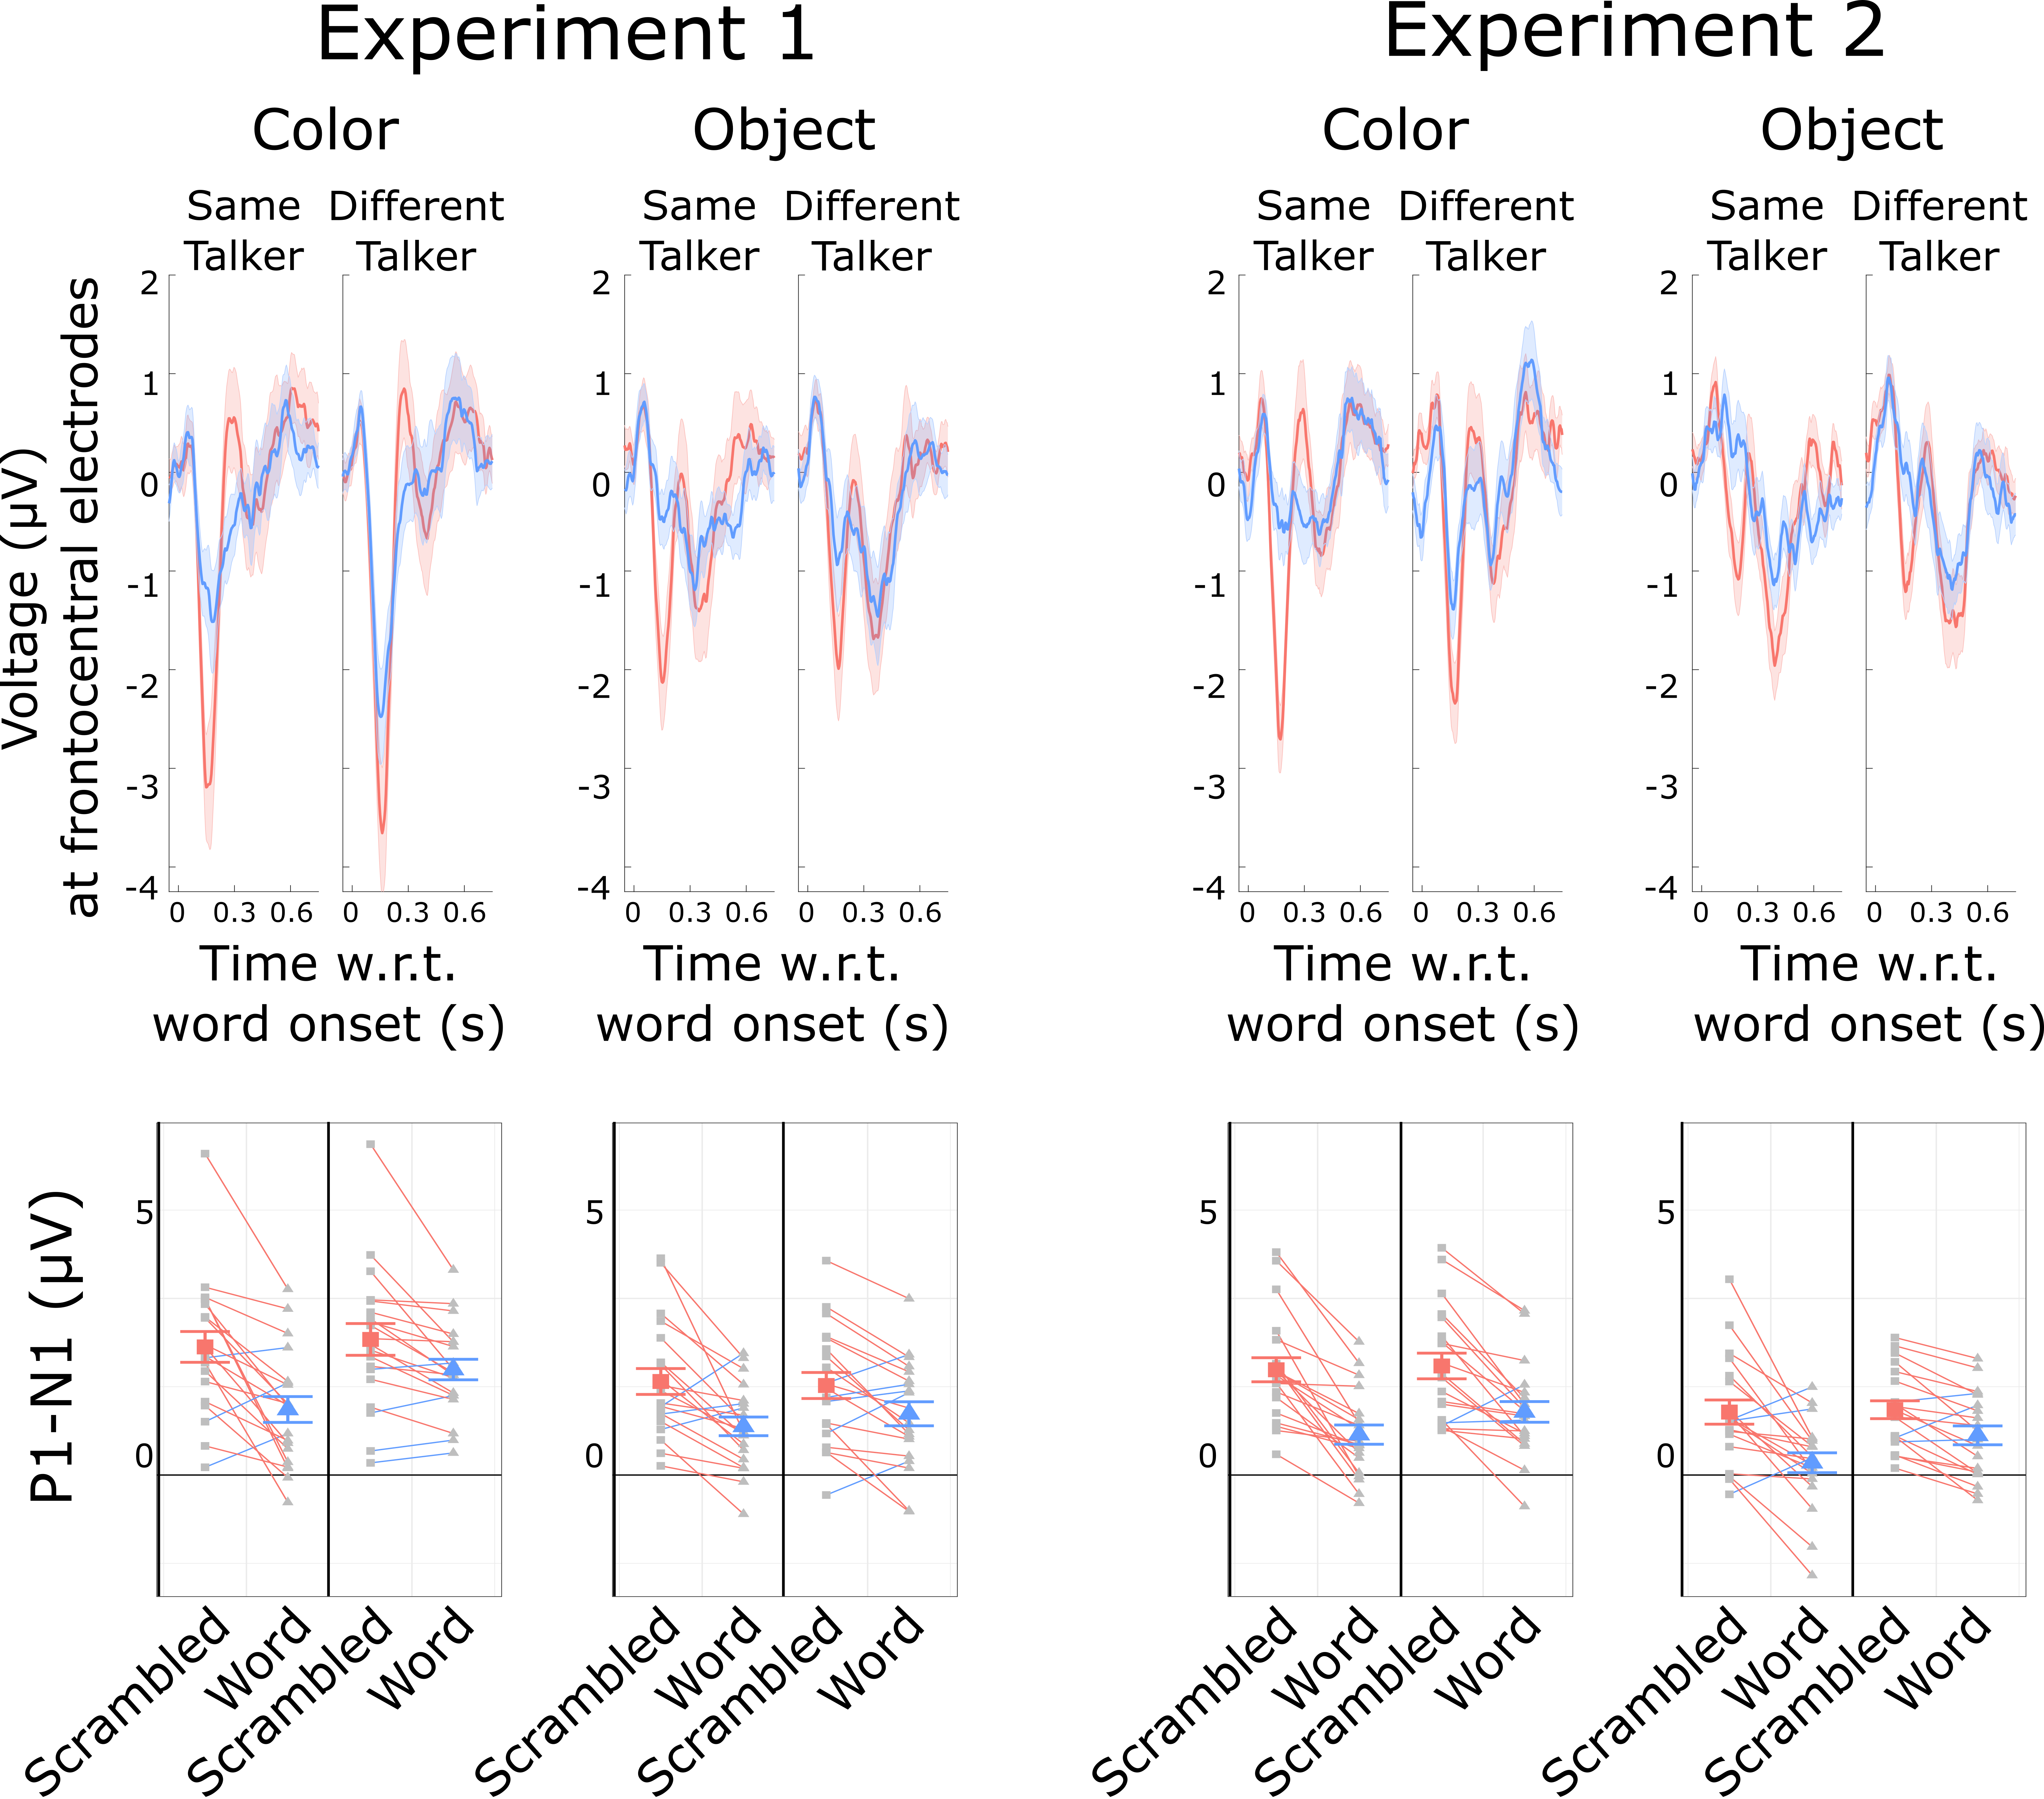
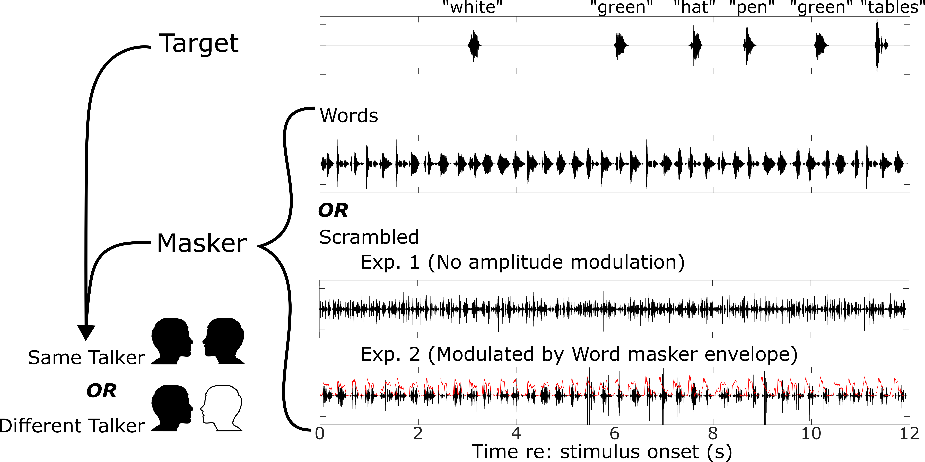
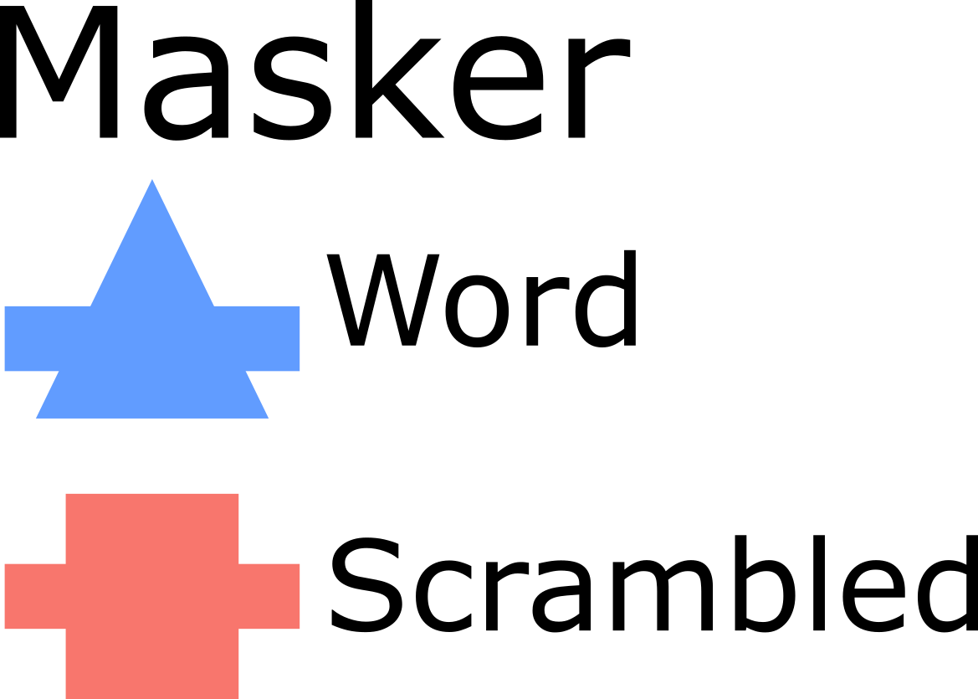
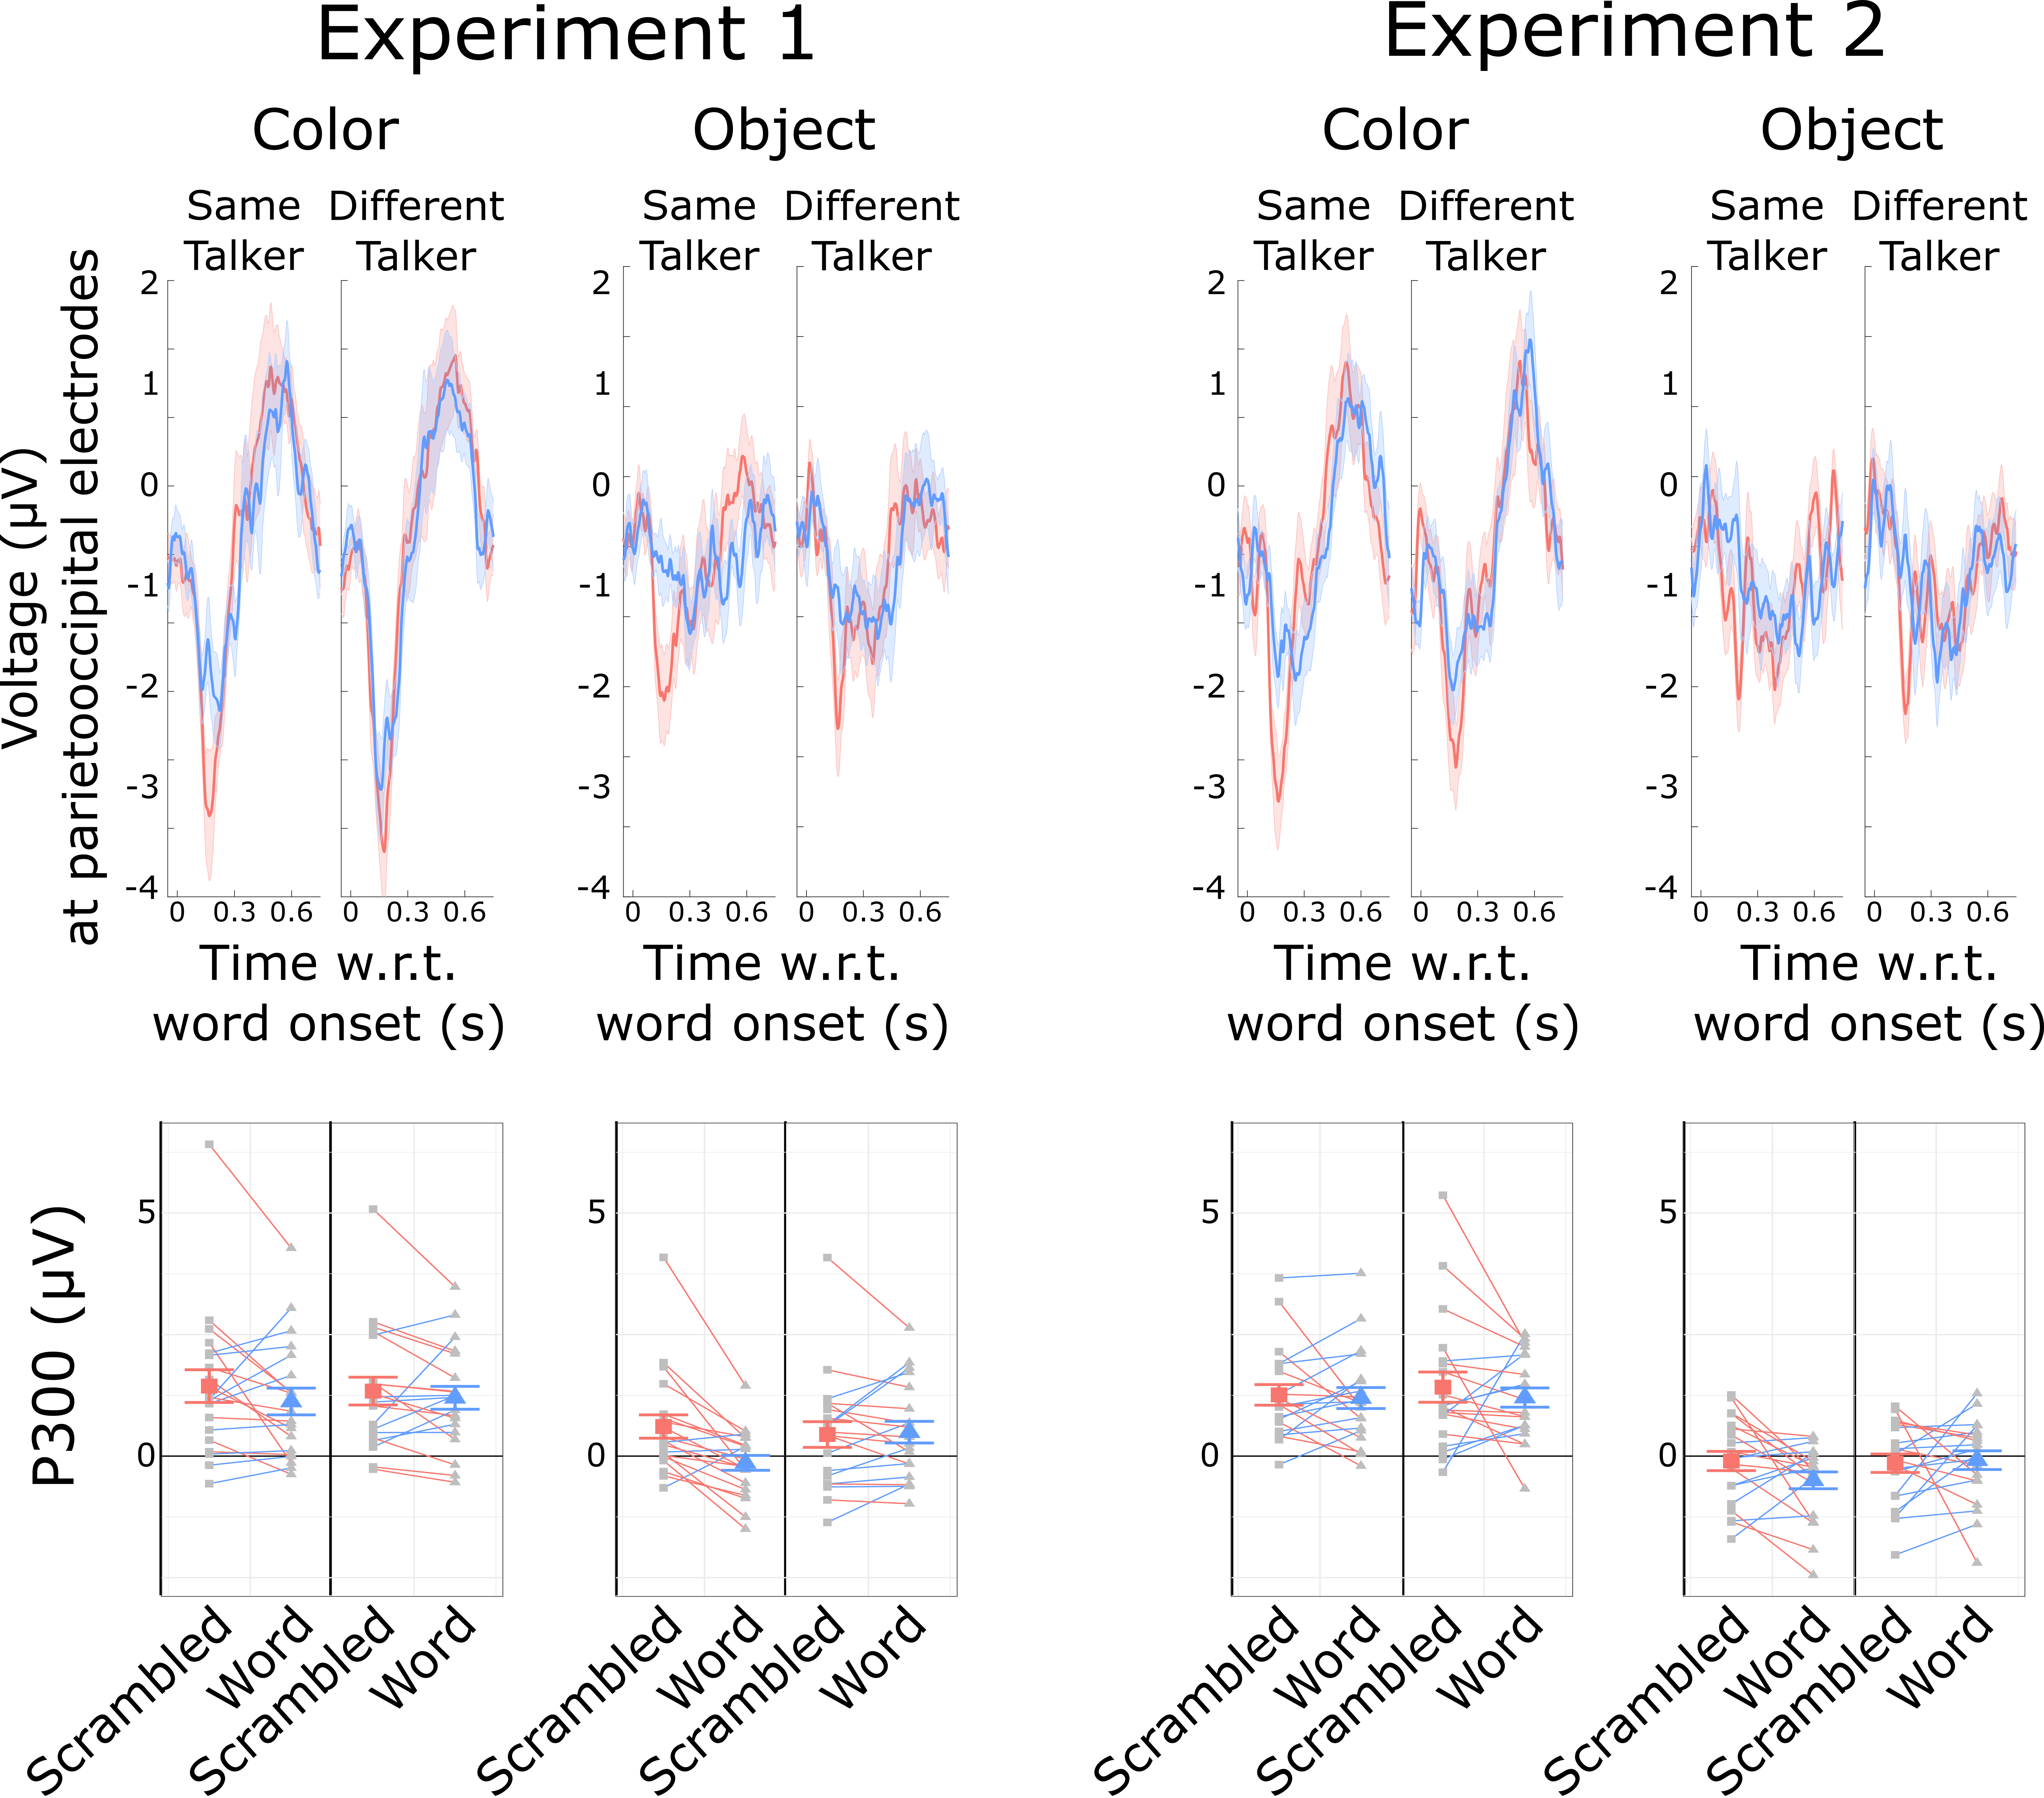
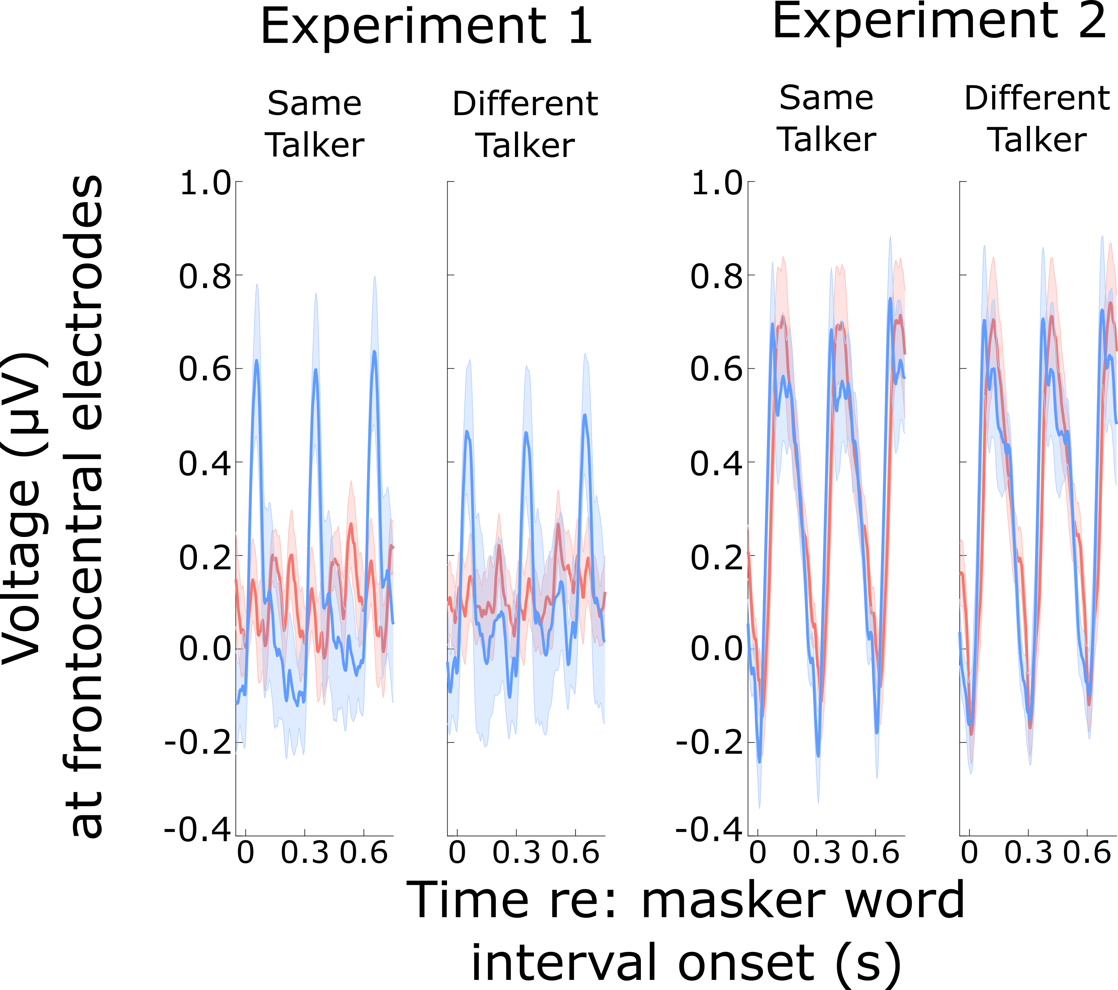
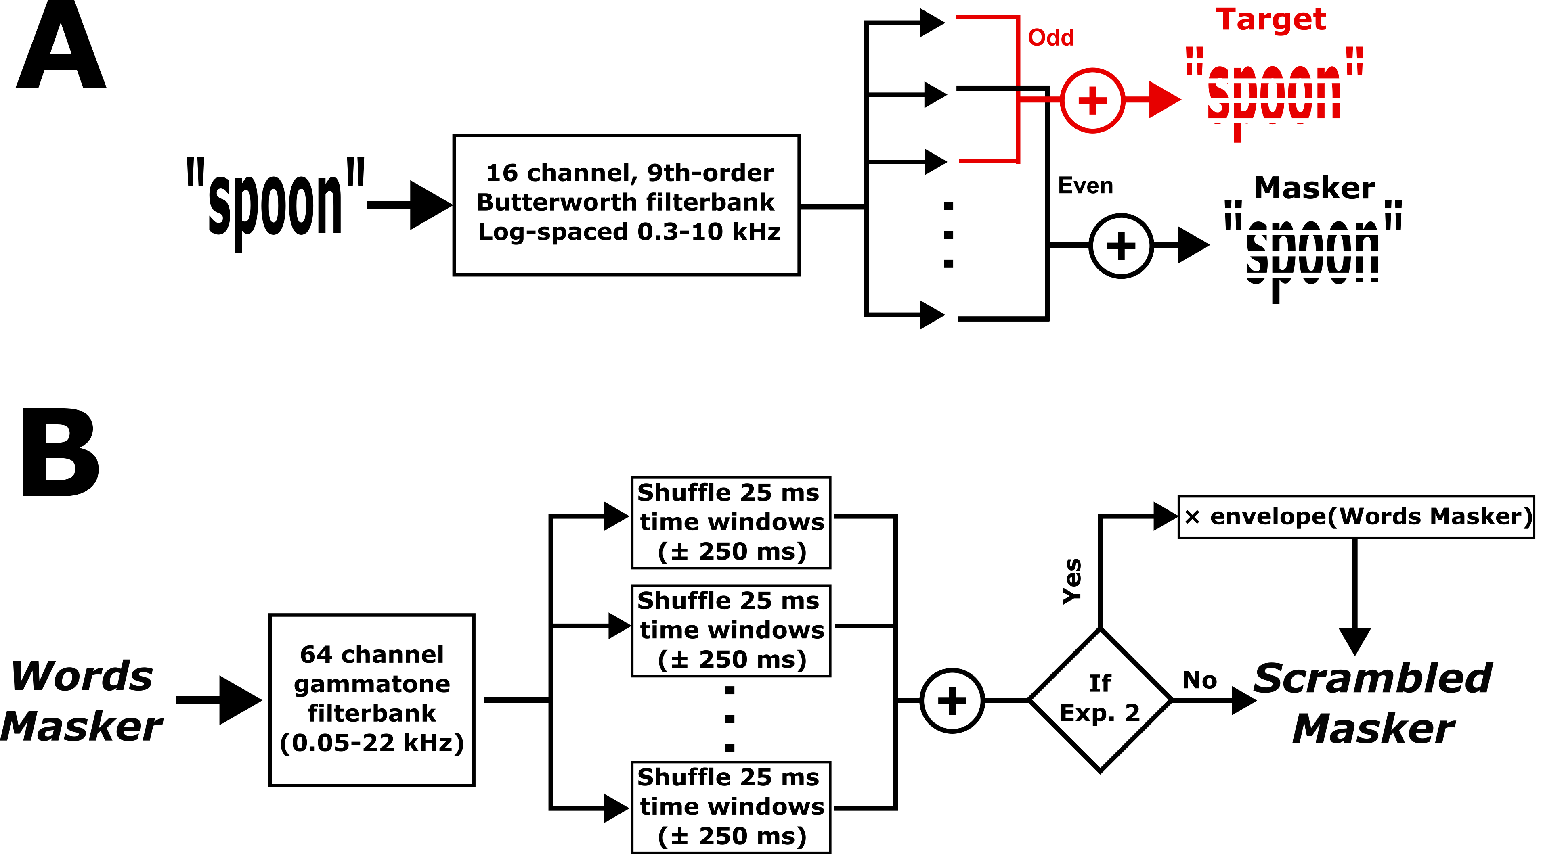




Intelligibility Modulates Early Attentional Filtering of Competing Speech
Benjamin N. Richardson¹, Maanasa Guru Adimurthy², Christopher A. Brown³, Merri J. Rosen⁴, Barbara G. Shinn-Cunningham^{1,5}
¹Neuroscience Institute, Carnegie Mellon University; ²Department of Psychiatry, University of Pittsburgh; ³Department of Communication Sciences and Disorders, University of South Florida;
⁴Department of Neurobiology, Northeast Ohio Medical University; ⁵Mellon College of Science, Carnegie Mellon University
Overview
Behavior Results
Sensory (P1-N1) responses to target words
Intelligible speech masks target speech more than unintelligible speech [1,2,3], but manipulations of intelligibility vary in the literature: time reversal, N-talker babble, vocoding, filtering, etc. [4,5,6,7].
Here, we controlled for acoustic differences between intelligible and unintelligible maskers, and measured neural responses.
Intelligible speech, which more readily masked target speech, modulated the P1-N1 response but not the P300 response, suggesting an early attentional filtering mechanism.
P1-N1 to target color words was larger than to object words in the target stream
P1-N1 to the target stream was significantly larger with a Scrambled masker than with a Word masker, especially when the talker was the same.
Hit rates were higher with a Scrambled than a Word masker, but only with same talker.
Within-stream false alarm rates (target object words) were higher with a word than scrambled masker, and greater with the same talker.
Between stream false alarm rates (masker color words) were low, but higher when the talker was the same.
Stimuli & Color Word Detection Task
Fig. 5. ERPs over frontocentral electrodes. Top row: Time traces averaged over participants, with bands showing the across-participant standard error of the mean. Bottom row: P1-N1 magnitude. Group average and standard error of the mean shown by large symbols. Individual participant data (thin lines) are colored according to which P1-N1 is larger.
Fig. 1. Schematic of a single task block. Listeners attended to the sporadic target stream (top row), and ignored a simultaneous, isochronous Masker that depended on condition (bottom rows).
Target recognition (P300) responses to target words
N = 20 normal hearing listeners in each of two experiments.
Listeners responded to color words in the target stream (Fig. 1).
Listeners ignored an isochronous masker: either words from the same set (”Words”), or scrambled speech (“Scrambled”).
Target and masker were spoken by the same or different talkers.
In Exp. 2, masker was amplitude modulated with a Word envelope
Target and masker were filtered into non-overlapping bands (Fig. 2A).
Scrambling (Fig. 2B) preserved local spectrotemporal density.
Fig. 3. Individual behavioral data (small symbols connected by thin lines) and across-subject average and standard error (large symbols with error bars).
ERPs to the masker stream
P300 was elicited strongly by color words in the target stream, but not by object words.
P300 was not modulated by masker intelligibility: No differences between P300 to the target between Word and Scrambled masker conditions, except for Exp 1. (Object, Same Talker)
In Exp. 1, ERPs followed the Words masker envelope but did not show rhythmic structure for a Scrambled masker.
In Exp. 2, we addressed this confound by amplitude modulating the Scrambled masker.
Fig. 6. ERPs over parietooccipital electrodes. Top row: Time traces averaged over participants, with bands showing the across-participant standard error of the mean. Bottom row: P300 magnitude. Group average and standard error of the mean shown by large symbols. Individual participant data (thin lines) are colored according to which P300 is larger.
Fig. 2. Controls for energetic masking and spectrotemporal properties. (A) Target and masker were filtered into non-overlapping frequency bands. (B) The scrambling process resulted in similar spectrotemporal density between Word and Scrambled maskers
EEG Methods and ERP Analysis
Fig. 4. ERPs evoked by masker streams over frontocentral electrodes, time locked to word onsets in the Word masker.
We measured 32-channel EEG throughout the task.
Preprocessing included manual artifact rejection, eye blink/saccade rejection using ICA, and rejection of ERPs with magnitude ± 100 V.
We measured event-related potentials (ERPs), and calculated…
P1-N1 sensory onset responses in frontocentral electrodes
P300 color word recognition responses in parietooccipital electrodes
References
Acknowledgements
F31-DC022481 to BNR
R21-DC018408 to CAB
R01-DC015988 to BGSC
R01-DC022699 to CAB & BGSC
ONR-N00014-23-1-2065 to BGSC
R01 DC019126 to MJR & BGSC
Contact
Summers, Robert J., and Brian Roberts. 2020. “Informational Masking of Speech by Acoustically Similar Intelligible and Unintelligible Interferers.” The Journal of the Acoustical Society of America 147 (2): 1113.
Van Engen, Kristin J., Jasmine E. B. Phelps, Rajka Smiljanic, and Bharath Chandrasekaran. 2014. “Enhancing Speech Intelligibility: Interactions among Context, Modality, Speech Style, and Masker.” Journal of Speech, Language, and Hearing Research: JSLHR 57 (5): 1908–18.
Rennies, Jan, Virginia Best, Elin Roverud, and Gerald Kidd Jr. 2019. “Energetic and Informational Components of Speech-on-Speech Masking in Binaural Speech Intelligibility and Perceived Listening Effort.” Trends in Hearing 23 (January). https://doi.org/10.1177/2331216519854597.
Scott, Sophie K., Stuart Rosen, Harriet Lang, and Richard J. S. Wise. 2006. “Neural Correlates of Intelligibility in Speech Investigated with Noise Vocoded Speech—A Positron Emission Tomography Study.” The Journal of the Acoustical Society of America 120 (2): 1075–83.
Pollack, Irwin. 2005. “Effects of High Pass and Low Pass Filtering on the Intelligibility of Speech in Noise.” The Journal of the Acoustical Society of America 20 (3): 259–66.
Cooke, Martin, and Youyi Lu. 2010. “Spectral and Temporal Changes to Speech Produced in the Presence of Energetic and Informational Maskers.” The Journal of the Acoustical Society of America 128 (4): 2059–69.
Van Engen, Kristin J., and Ann R. Bradlow. 2007. “Sentence Recognition in Native- and Foreign-Language Multi-Talker Background Noise.” The Journal of the Acoustical Society of America 121 (1): 519–26.
Your future postdoc might be just a scan away…
https://bnrichardson.net

